Slide 1
Participant Engagement Analysis – Birding Challenge
Nature Conservation Foundation (NCF) – Internship Project
By Khushi M Appannavar - 08/08/2025

Slide 2
Content
Introduction
My internship with BCI
Project overview
Methodology
Analysis

Slide 3
Introduction
Bird Count India is a citizen science project allows birdwatchers to submit sightings via eBird.
Each challenge varies - e.g., log specific bird species, bird a certain number of days, log species from specific habitats, etc.
Participants submit checklists via the eBird app or website following set guidelines.
Results are declared based on eBird data, and participants are featured by Bird Count India.
Notable efforts are publicly recognized.

Slide 4
My Internship with Bird Count India
Intern under the data analysis and visualization domain.
Tasked with examining participant engagement in the eBirding Challenge.
Developed tools to extract, clean, analyze, and visualize birding data.

Slide 5
Project overview
Objective: Analyze and visualize participant engagement patterns
Duration: 2 months (June & July)
Data Source: NCF’s birding challenge pages
Output: Visual dashboards + analytical summaries

Slide 6
Methodology
Web scraping the challenge using Python (BeautifulSoup)
Data cleaning & structuring into challenges and results
Marking the challenges into 6 categories
Species based
Media based
Time based
Trend analysis over time (weekly/monthly)
Tools used: Python, Pandas, Matplotlib/Seaborn, Excel
List based
Habitat based
Location based

Slide 7
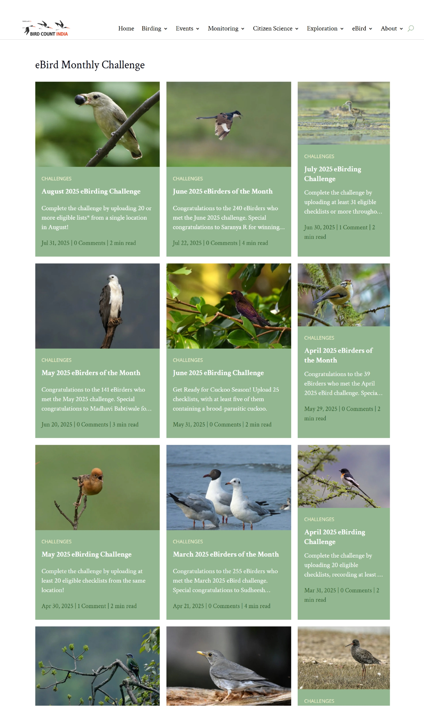
The eBird Monthly Challenge Website link

Slide 8
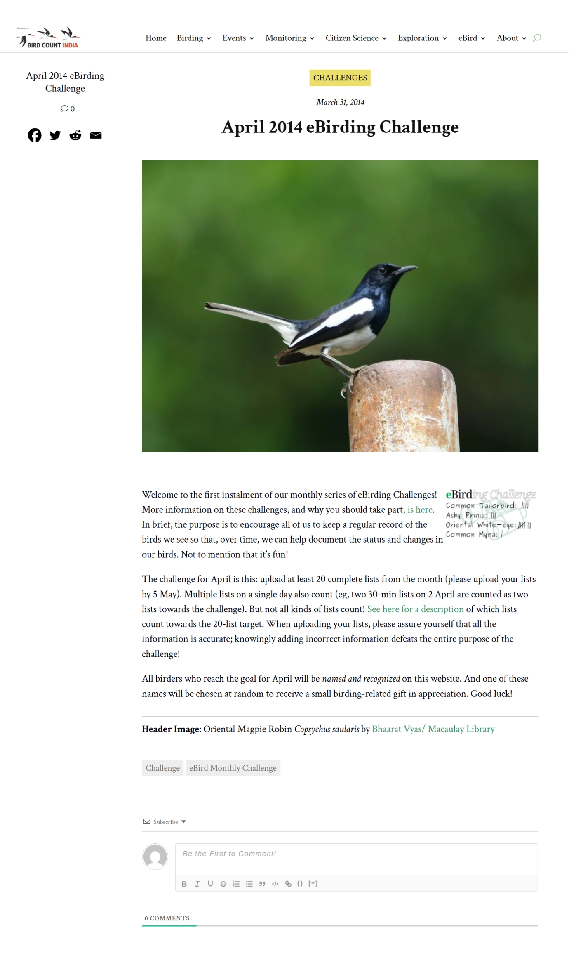
Web scraping results
Web scraping 1 link

Slide 9
Methodology
Web scraping the challenge using Python (BeautifulSoup)
Data cleaning & structuring into challenges and results
Marking the challenges into 6 categories
Species based
Media based
Time based
Trend analysis over time (weekly/monthly)
Tools used: Python, Pandas, Matplotlib/Seaborn, Excel
List based
Habitat based
Location based

Slide 10
Web scraping results
Web scraping 2 and preprocessing
Month | Year | Article URL | List based | Location based | Species based | Habitat based | Media based | Time based | Content | names_of_birders
April | 2014 | https://birdcount.in/apr14-challenge/ | 1 | 0 | 0 | 0 | 0 | 1 | Welcome to the first instalment of our monthly series of eBirding Challenges! More information on these challenges, and why | ["Aidan & Savio Fonseca", "Anish Aravind", "Arya Vinod", "Bela Arora", "Dhananjai Mohan", "Ganeshwar S V"
May | 2014 | https://birdcount.in/may14-challenge/ | 1 | 0 | 0 | 0 | 0 | 1 | While we wait until 5th May to allow enough time for eBirders to enter their April lists, it's time to announce the May eBirding | ["Aidan & Savio Fonseca", "Anish Aravind", "Arya Vinod", "Bela Arora", "Ganeshwar SV
June | 2014 | https://birdcount.in/june14-challenge/ | 1 | 1 | 0 | 0 | 0 | 1 | The eBirding Challenge for June is this: Choose at least four distinct locations, and from each, upload at least five complete bird lists | ["abhijith a.p.c", "Abhijith surendran", "abhirami-niranjana C", "Able Lawrence", "adit soans", "Aidan &
July | 2014 | https://birdcount.in/jul14-challenge/ | 1 | 0 | 0 | 0 | 0 | 1 | The Challenge for June was quite steep: upload at least five lists from each of at least four distinct locations. Were you able to | ["Abhijith Surendran", "Able Lawrence", "Anish Aravind", "Anshuman Sarkar", "Arun Lal", "Arya
August | 2014 | https://birdcount.in/aug14-challenge/ | 1 | 0 | 0 | 0 | 0 | 1 | After a couple of tough challenges in June and July, we return to a slightly simpler challenge for August -- in fact the same target | ["Abha Manohark", "Abhijith surendran", "Able Lawrence", "Aidan & Savio Fonseca", "Arjun R", "Arya

Slide 11
Methodology
Web scraping the challenge using Python (BeautifulSoup)
Data cleaning & structuring into challenges and results
Marking the challenges into 6 categories
Species based
Media based
Time based
Trend analysis over time (weekly/monthly)
Tools used: Python, Pandas, Matplotlib/Seaborn, Excel
List based
Habitat based
Location based

Slide 12
Analysis

Slide 13
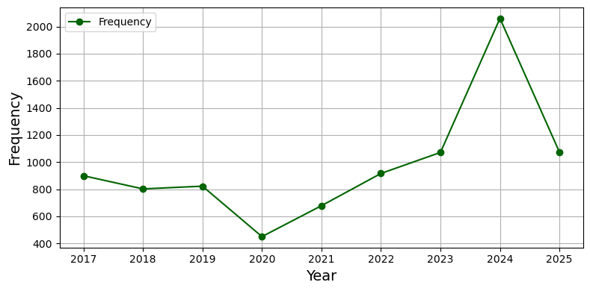
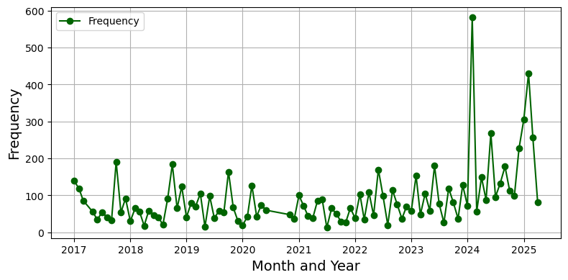
Participant Trends
Participant trends every year
Participant trends every month

Slide 14
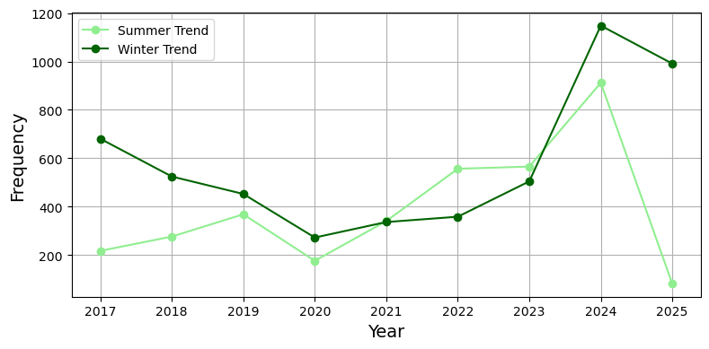
Participation Frequency (Summer vs Winter)
Summer VS Winter - Participation Frequency by Year (2027 to Present)

Slide 15
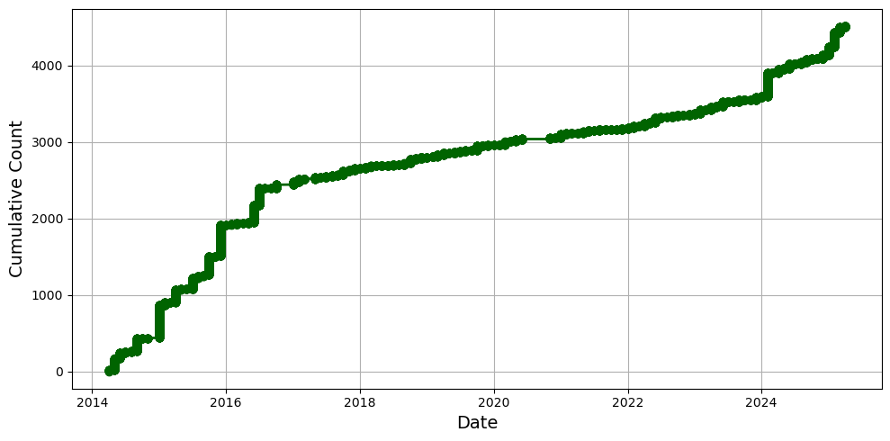
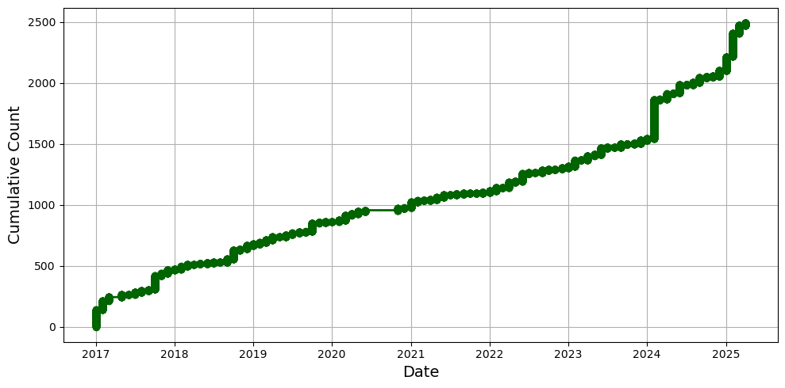
Cumulative New People Joining Over Time
New People Joining (since 2017)
New People Joining (since 2014)

Slide 16
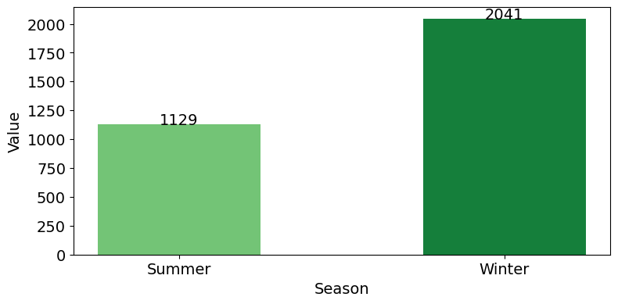
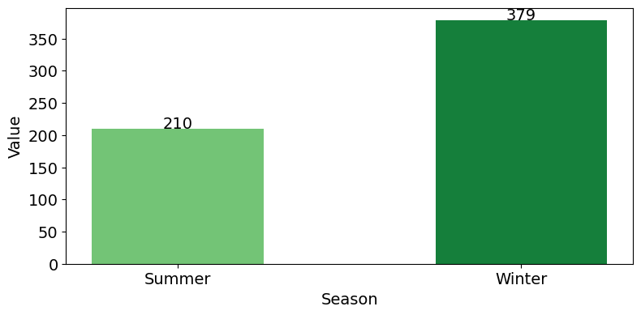
Seasonal Participation – Summer v/s Winter
Summer vs Winter – Total Unique participants (Since 2017)
Summer vs Winter – Yearly Average Unique participants (Since 2017)

Slide 17
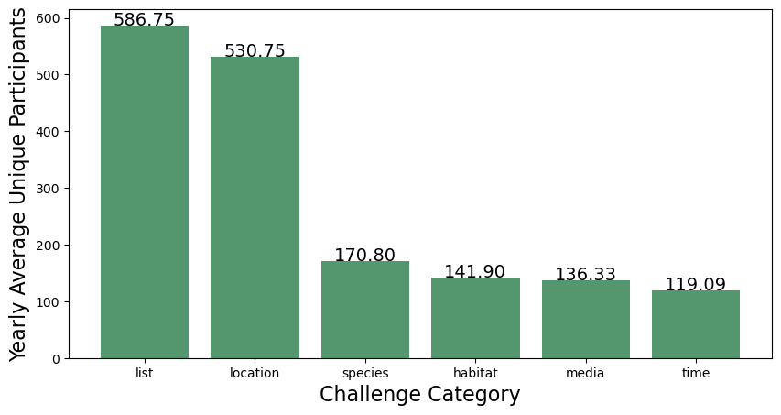
Unique participation in each category
Yearly average unique participants in each category

Slide 18
Thank you

